Slide 1
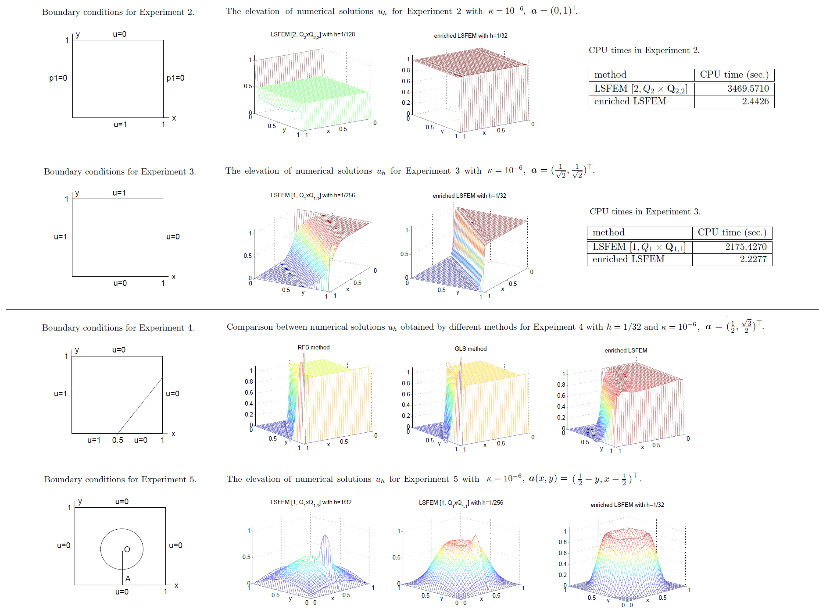
A novel least-squares finite element method for solving convection-dominated problems
Xxx-Xxx Hsieh (謝XX), Department of Mathematics, National Central University, Taiwan (xxxx@math.ncu.edu.tw)
Advisor: Prof. Xxx-Xxx Yang (楊XX)
Abstract
Problem description
Conclusions
Results
Discussion
References

