Slide 1
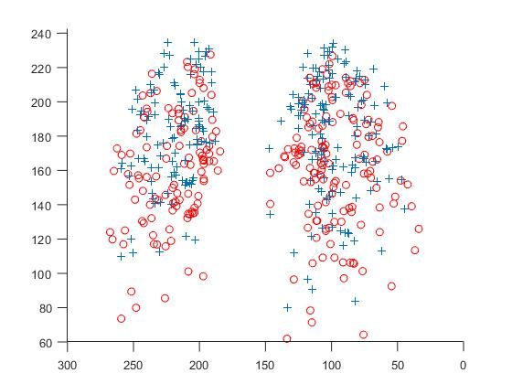
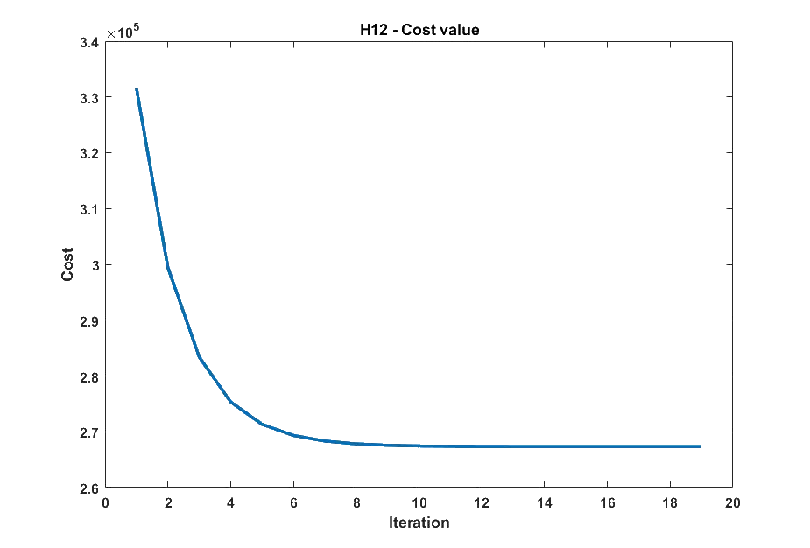
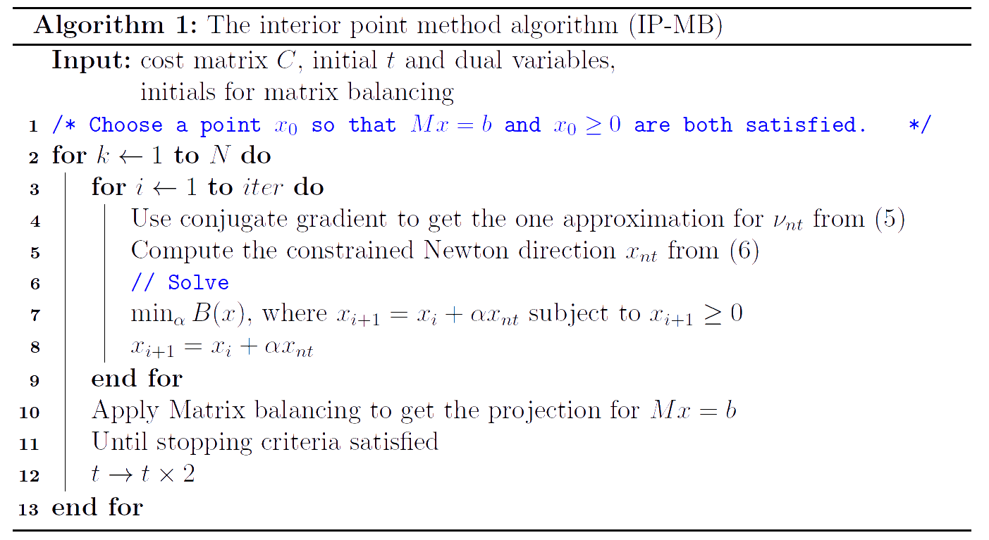
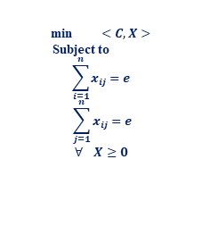
An interior point method based algorithm to match lung branch point sets at FRC/TLC phases
Janith Wijesinghe (查維詹), Department of Applied Mathematics, National Chung Hsing University, Taiwan (janithuop@gmail.com)
Advisor: Prof. Pengwen Chen (陳鵬文)
Abstract
Introduction
Methodology
In this study, we introduce the algorithm based on the Interior point method to solve the point sets matching problem. Inside the inner loop we use the Conjugate gradient method to get the newton direction and also Matrix balancing[1] as a projection to keep $x$ in the feasible region. The results indicate that we have use our algorithm to match point sets of cardinality about 2000. The results will reveal; the algorithm can use for large scale of data successfully.
In this study we aim to reconstruct the correspondence between the lung branch point sets. We have two lung branch points $Y_{i}$ and $Z_{j}$. Then we introduce $C={\left|Y_{i}−Z_{j}\right|}^{2}$.
After solve problem (1) actually $X$ gives the correspondence. One possible model has been proposed in [2] where authors consider optimal mass transform problem.
Here in (1) shows the optimal mass transportation problem , Where, $<C,X>$describe $Tr\left(C^{T}X\right),$and $C∈𝓡^{n×n}$, X $∈𝓡^{n×n}$, $e∈𝓡^{n}$, e is a vector of ones.
In this work, we consider the algorithms, symmetric version of ADMM [3], The mirror decent method, and linear programming.
The principal aim of this study is to derive a new algorithm to solve the above discussion problem using Interior Point method with an eye on speed, especially for large systems.
Since the matrices $C$, $M$ are not formed the explicitly, the proposed algorithm can handle large scale point sets.
While we developing our algorithm we will use Conjugate gradient and matrix balancing too.
As convergence conditions for the proposed algorithm we use KKT conditions.
Interior-Point method for solving convex optimization problems that include inequality constraints and consider our assignment problem (1) as a convex optimization problem, then transfer it into the standard form.
minimize $<C,x>$
subject to $−x≤0 , ∀ x_{i}$
$Mx=b$
Here $Mx=b$ shows the two equality constraints sets in our main problem and $b∈𝓡^{2n}$ (here b is a vector of ones.).
Where $M∈𝓡^{2n×n^{2}}$is a matrix with a special pattern. As an example for $n=2$,
We associate a barrier function 𝐵(𝑥) (called the logarithmic barrier function) defined as,
$$B\left(x\right)=tC^{T}x−\sum_{i=1}^{n}{\log{x_{i}}}, t>0$$
We consider the problem of minimizing the above barrier function
min 𝐵(𝑥) subject to 𝑀𝑥 = 𝑏 (3)
Assume that (3) is solvable and optimal $x^{∗}$exists with satisfying the KKT conditions.
The KKT condition related to (3) is:
$Mx=b, −x≤0 , λ ≥0$
$$C+\sum_{i=1}^{m}{λ_{i}}∇\left(−x\right)+M^{T}Γ=0$$
$$λ_{i}x=1/t$$
Where dual optimal$λεℛ^{n^{2}}$ and $Γεℛ^{n^{2}}$were exist.
Newton equation for the centering problem (3) is given by[4]
$\left[\begin{matrix}diag{\left(x\right)}^{−2} & M^{T} \\ M & 0\end{matrix}\right] \left[\begin{matrix}x_{nt} \\ ν_{nt}\end{matrix}\right]= \left[\begin{matrix}−tC+diag{\left(x\right)}^{−1}1 \\ 0\end{matrix}\right]$(4)
Using block elimination, we can have,
min $<C,X>$
Subject to
$$\sum_{i=1}^{n}{x_{ij}=e}$$
$$\sum_{j=1}^{n}{x_{ij}=e}$$
$$∀ X≥0$$
(1)
(2)
$$M=\left[\begin{matrix}1 & 1 & 0 & 0 \\ 0 & 0 & 1 & 1 \\ 1 & 0 & 1 & 0 \\ 0 & 1 & 0 & 1\end{matrix}\right]$$
Figure 3:Examples of 3D image data of lungs
Figure 1: image of optimal x of H12
Figure 2: cost value
Results and discussion
Table 01: The comparison between the algorithms using processing time. (time unit in seconds)
Algorithm
To compare interior-point method algorithm (IP-MB) against other algorithms, we obtained the numerical results to the assignment problem.
We then compared the performance of the Interior point method approach against the Symmetric ADMM algorithm, mirror descent algorithm and linprog function. $C$is generated from MATLAB function “magic”. For the ADMM algorithm we can have different step sizes[3] and so, here we use the most efficient step sizes $r=s=0.75$.
From the table 01, it is clear that Interior point method becomes the most efficient algorithm. Also for even large scale of matrices it could handle easily than the other algorithms.
We have applied the Interior algorithm to the real data sets of match lung branch point sets at FRC/TLC phases. Where the cardinality about 200- 300 and for large scale cardinality is 2000.
Figures 1 and 2 show the solution of H12 data set and it will reveal the efficient and accuracy of Interior algorithm.
n | IP-MB | ADMM | Mirror descent | Linprog
50 | 3.53 | 2.21 | 829.19 | 0.10
100 | 6.44 | 104.11 | 5416.47 | 0.267
500 | 634.30 | >12591 | >5943.28 | 7.55
1000 | 5555.45 | >5556 | fail | fail
2000 | 13256.81 | fail | fail | fail
Table 2: Table of numerical results
Data set | n | Time(s)
H12 | 254 | 71.55
H19 | 243 | 63.08
H72 | 171 | 32.80
H74 | 188 | 42.43
H78 | 181 | 39.10
H83 | 128 | 13.32
$M$diag${(x)}^{2}M^{T}ν_{nt}= −tM$diag${(x)}^{2}C+b$
$x_{nt}= −t$diag${(x)}^{2}C+x−$diag${(x)}^{2}M^{T}ν_{nt}$
(5)
(6)
Conclusion
References
[1] P. A. Knight and D. Ruiz, “A fast algorithm for matrix balancing,” IMA J. Numer. Anal., vol. 33, no. 3, pp. 1029–1047, 2013, doi: 10.1093/imanum/drs019.
[2] P. Chen, C. L. Lin, and I. L. Chern, “A perfect match condition for point-set matching problems using the optimal mass transport approach,” SIAM J. Imaging Sci., vol. 6, no. 2, pp. 730–764, 2013, doi: 10.1137/12086443X.
[3] B. He, F. Ma, and X. Yuan, “Convergence Study on the Symmetric Version of ADMM with Larger Step Sizes,” SIAM J. Imaging Sci., vol. 9, no. 3, pp. 1467–1501, Jan. 2016, doi: 10.1137/15M1044448.
Table 3: Table of numerical results for Lower lung lob data (LLB data)
The advantage of this algorithm is we can handle very large scale point sets of cardinality of about 2000.
To further enlarge the cardinality we will use sparse pattern to consider incorporating some prior information regarding the elastic knowledge and the generating tree information.
n | IP-MB | ADMM
2000 | 10 h and 21 min | >15 h
*Real data were taken from Prof. Ching-Long Lin, Department of Mechanical and Industrial engineering, University of Iowa, Iowa city

